Slide 1


Snowflake Hackathon 2025
Logistics Maritime Use Case - OceanLink Logistics
PT Password Solusi Sistem
Oktober 2025

Slide 2
Agenda
1
Password Team’s Introduction
5
Password Team’s High Level Solution
2
OceanLink’s Business Process
6
Password Team’s Solution Architecture
3
OceanLink’s Challenges
7
Password Team’s Scenario Testing
4
Password Team’s Proposed Solution
8
Password Team’s Closing Statements

Slide 3

Password Team’s Introduction
1
2
3
Vincent Velasco
Lead Developer
Yehuda Chaniago
Business Analyst
Gonada Tambunan
Presenter

Slide 4
OceanLink’s Business Process
Maritime logistics is the management and coordination of goods transported by sea, encompassing all activities from cargo planning to final delivery. It plays a crucial role in global trade, handling over 80% of the world’s goods movement through ports and ocean routes.
The process typically begins with voyage planning and scheduling, where shipping lines organize routes, allocate vessels, and manage bookings. Next, cargo handling and port operations ensure goods are efficiently loaded, documented, and secured for transport. During the voyage, real-time monitoring through IoT sensors and AIS tracking allows operators to oversee vessel performance, fuel usage, and weather conditions. Upon arrival, port unloading and distribution complete the logistics chain.
Overall, maritime logistics integrates technology, data analytics, and coordination between shipping companies, ports, and inland transport partners to ensure timely, cost-effective, and sustainable delivery across international supply networks.

Slide 5
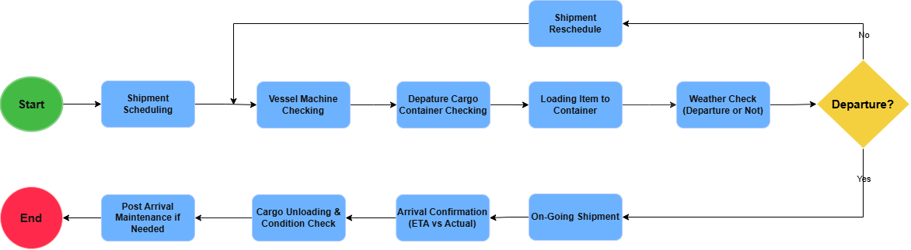
OceanLink’s General Flow

Slide 6






OceanLink’s Challenges
Multimodal Data Integration
Shipment Efficiency & Delay Optimization
Predictive Maintenance & Asset Health

Slide 7
Real Case
Weather Related News
The article “2025 Tropical Storm & Typhoon Season Outlook: Northwest Pacific & North Indian Ocean” (August 31 2025) outlines key weather-risk trends for major maritime regions:
In the Northwest Pacific, typhoon activity is expected to remain near average (~24 storms), with elevated risk for routes around Japan in October when storms may approach closer to the mainland and develop faster due to a stronger Pacific high-pressure system.
In the North Indian Ocean, conditions in the Bay of Bengal are favorable for increased cyclone formation in the post-monsoon period (October – December). The forecast suggests ~3 storms in the Bay (normal ~2.6) and ~1 in the Arabian Sea, highlighting elevated risk for vessels operating in these corridors.
Key risk areas identified include: East China Sea, South China Sea, shipping lanes near southern Japan, and Bay of Bengal routes. These zones can face compressed warning lead-times and rapid storm development.
Sources: https://sea.weathernews.com/resources/202508/37 ((Updated) 2025 Tropical Storm & Typhoon Season Outlook: Northwest Pacific & North Indian Ocean)

Slide 8





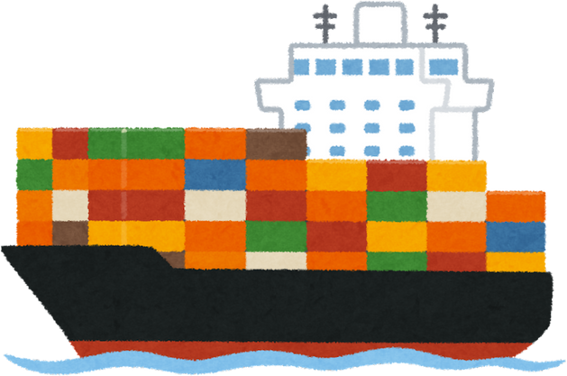
Password Team’s Proposed Solutions
Challenges
Solutions
Benefits
Multimodal Data Integration
Document AI
Audio Transcribe
Cortex Complete
Single Source of Truth & Data Consolidation
Shipment Efficiency & Delay Optimization
Improve On-Time Performance & Cost Efficiency
Cortex Agents
Predictive Maintenance & Asset Health
Reduced Downtime & Enhanced Vessel Reliability

Slide 9


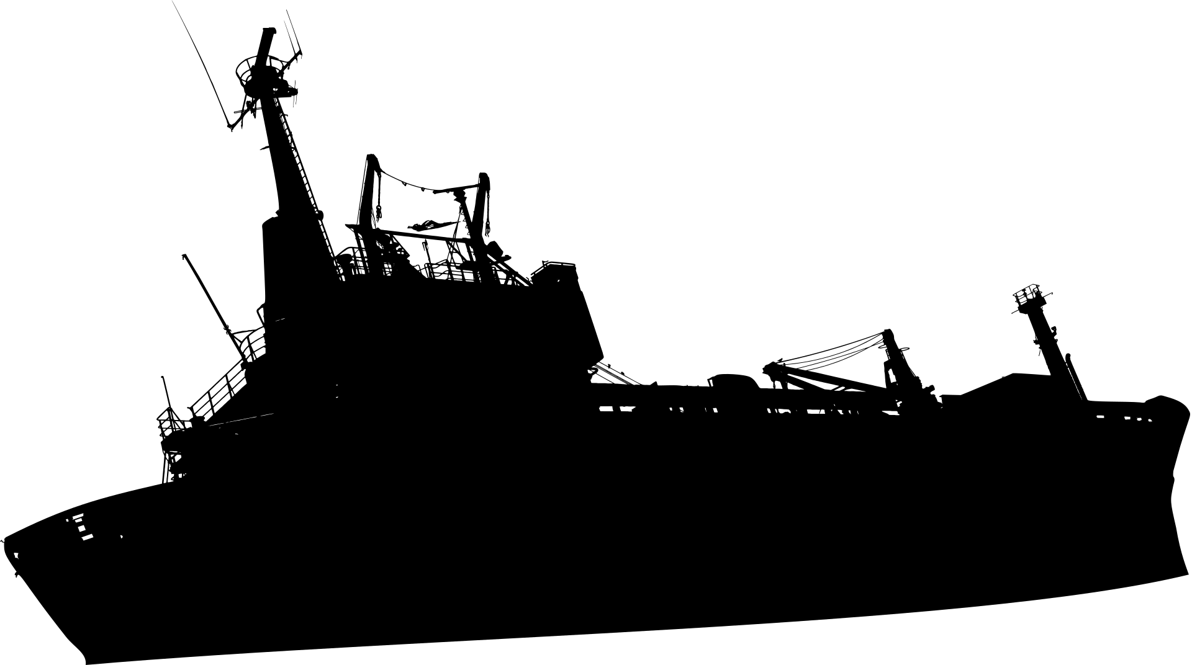
Password Team’s High Level Solutions
Unifying All Existing Data
Smarter Shipping Decisions
Proactive Ship Maintenance
Notes:
All data are going to be unified in a centralized platform so all data with different kind of files format are going to be transformed into a single format which is tables
Smarter shipping decision: From data regarding shipping performance, weather conditions data, and other shipping data, we can analyzed the reasons of delayed shipping, how to increase the efficiency of shipping lines
Proactive Ship Maintenance:
By getting data before, during and after a shipping process, we can proactively determine when and which vessel needs maintenance and reduces the amount of problems that can occur

Slide 10
Password Team’s Solutions Architecture
Dataset
Voyage Operations
Data
Description
Data Types
1. Shipment Schedule
Define Routes, ETA, & Utilizations
Structured
2. Fuel Cost Logs
Track fuel usages
Structured
3. Financial Expenditure
Track all expenses fuel, port fees, etc.
Structured
4. IOT Telemetry
Monitor live ship operations (RPM, Vibration, etc).
Structured
5. Customer Complaints
Reflects service quality & delivery satisfaction
Structured
Notes:
All data are going to be unified in a centralized platform so all data with different kind of files format are going to be transformed into a single format which is tables
Smarter shipping decision: From data regarding shipping performance, weather conditions data, and other shipping data, we can analyzed the reasons of delayed shipping, how to increase the efficiency of shipping lines
Proactive Ship Maintenance:
By getting data before, during and after a shipping process, we can proactively determine when and which vessel needs maintenance and reduces the amount of problems that can occur

Slide 11
Password Team’s Solutions Architecture
Dataset
Weather Observations
Data
Description
Data Types
1. Weather Forecast
Real-time measurement of conditions like wind, waves, and temperature
Semi-Structured (JSON)
2. Weather Observation
Advanced warnings and advisories
Structured
Notes:
All data are going to be unified in a centralized platform so all data with different kind of files format are going to be transformed into a single format which is tables
Smarter shipping decision: From data regarding shipping performance, weather conditions data, and other shipping data, we can analyzed the reasons of delayed shipping, how to increase the efficiency of shipping lines
Proactive Ship Maintenance:
By getting data before, during and after a shipping process, we can proactively determine when and which vessel needs maintenance and reduces the amount of problems that can occur

Slide 12
Password Team’s Solutions Architecture
Dataset
Asset Health Inspection
Data
Description
Data Types
1. Maintenance Checks
Routine inspections before/after voyage
Structured
2. Maintenance Logs
Records repair activities, duration, and severity
Structured
3. Cargo Check
Physical condition assessment of cargo and containers
Images
4. Crew Logs
Real-time updates or safety voice reports from the crew
Audio
5. Incident Reports
Summaries of operational or technical incidents
Unstructured (PDF)
Notes:
All data are going to be unified in a centralized platform so all data with different kind of files format are going to be transformed into a single format which is tables
Smarter shipping decision: From data regarding shipping performance, weather conditions data, and other shipping data, we can analyzed the reasons of delayed shipping, how to increase the efficiency of shipping lines
Proactive Ship Maintenance:
By getting data before, during and after a shipping process, we can proactively determine when and which vessel needs maintenance and reduces the amount of problems that can occur

Slide 13
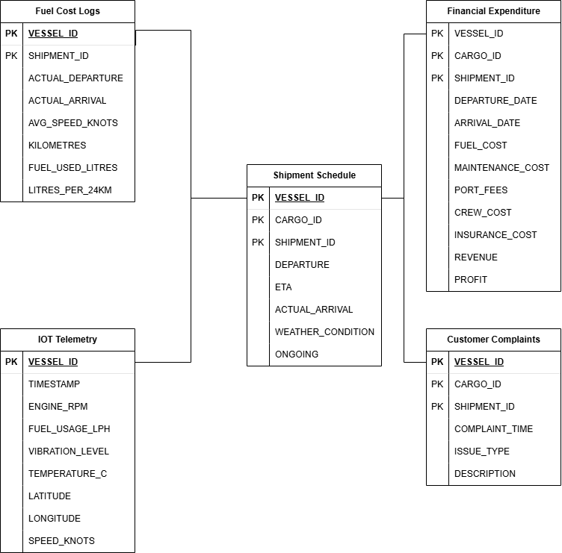
Password Team’s Solutions Architecture
Dataset
Voyage Operations
Notes:
All data are going to be unified in a centralized platform so all data with different kind of files format are going to be transformed into a single format which is tables
Smarter shipping decision: From data regarding shipping performance, weather conditions data, and other shipping data, we can analyzed the reasons of delayed shipping, how to increase the efficiency of shipping lines
Proactive Ship Maintenance:
By getting data before, during and after a shipping process, we can proactively determine when and which vessel needs maintenance and reduces the amount of problems that can occur

Slide 14
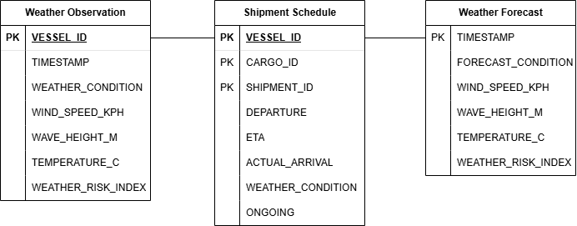
Password Team’s Solutions Architecture
Dataset
Weather Observations
Notes:
All data are going to be unified in a centralized platform so all data with different kind of files format are going to be transformed into a single format which is tables
Smarter shipping decision: From data regarding shipping performance, weather conditions data, and other shipping data, we can analyzed the reasons of delayed shipping, how to increase the efficiency of shipping lines
Proactive Ship Maintenance:
By getting data before, during and after a shipping process, we can proactively determine when and which vessel needs maintenance and reduces the amount of problems that can occur

Slide 15
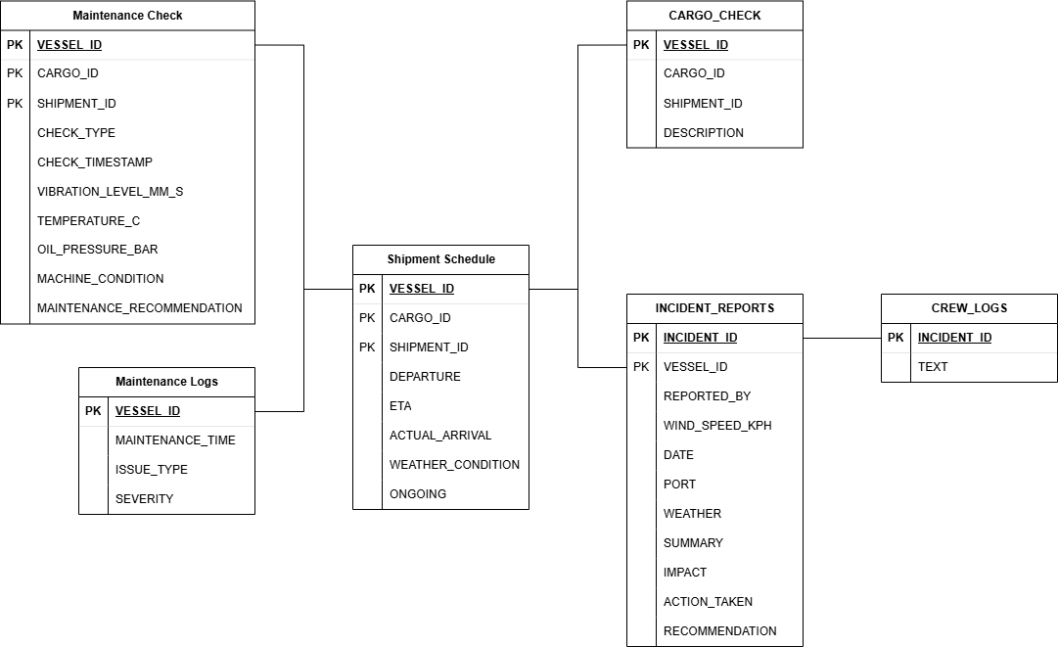
Password Team’s Solutions Architecture
ERD
Asset Health Inspection
Notes:
All data are going to be unified in a centralized platform so all data with different kind of files format are going to be transformed into a single format which is tables
Smarter shipping decision: From data regarding shipping performance, weather conditions data, and other shipping data, we can analyzed the reasons of delayed shipping, how to increase the efficiency of shipping lines
Proactive Ship Maintenance:
By getting data before, during and after a shipping process, we can proactively determine when and which vessel needs maintenance and reduces the amount of problems that can occur

Slide 16




Password Team’s Solutions Architecture
Architecture
Raw Data
Ingestion
Transformation
Data Warehouse
Cortex Tools
Output
Crew Logs
Voyage Operations Cortex Analyst
Voyage Operations
Document AI
Audio Transcribe
Cortex Complete
Incident Reports
Snowflake
Internal Stage
Weather Observations Cortex Analyst
Weather Observations
Snowflake Intelligence
Cargo Container
Snowflake SQL
Asset Health
Asset Health
Cortex Analyst
All Structured Data
Notes:
All data are going to be unified in a centralized platform so all data with different kind of files format are going to be transformed into a single format which is tables
Smarter shipping decision: From data regarding shipping performance, weather conditions data, and other shipping data, we can analyzed the reasons of delayed shipping, how to increase the efficiency of shipping lines
Proactive Ship Maintenance:
By getting data before, during and after a shipping process, we can proactively determine when and which vessel needs maintenance and reduces the amount of problems that can occur

Slide 17
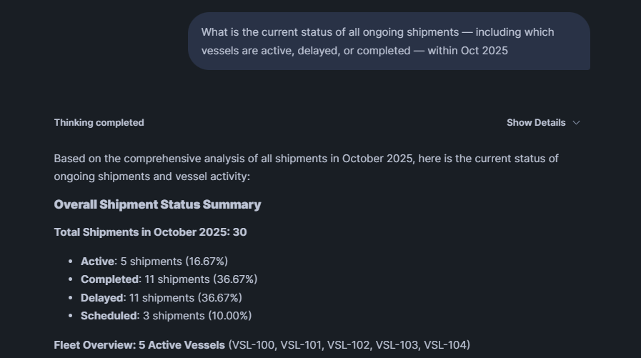
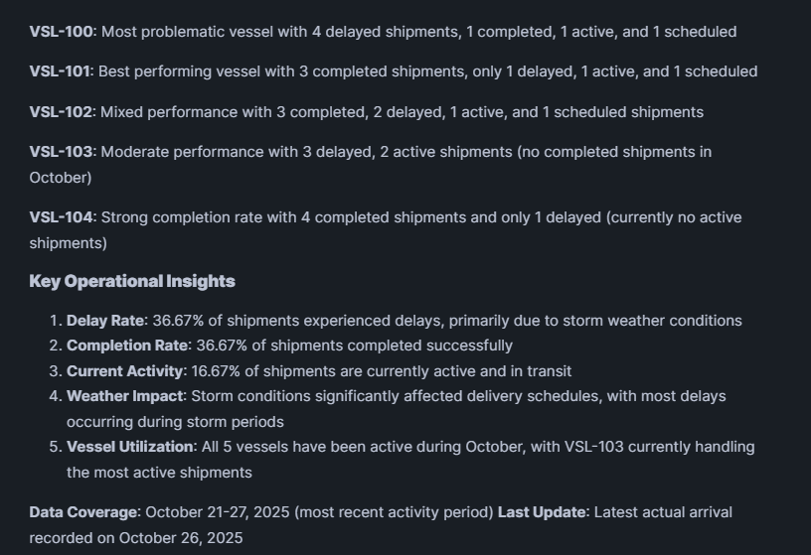
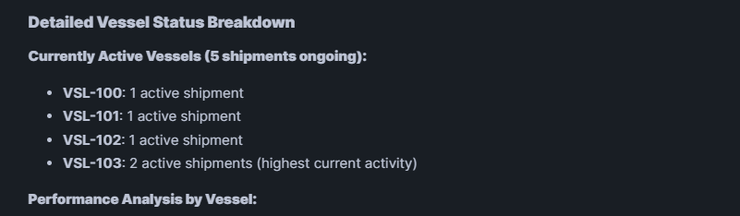
Password Team’s Scenario Testing
Questions #1
Notes:
All data are going to be unified in a centralized platform so all data with different kind of files format are going to be transformed into a single format which is tables
Smarter shipping decision: From data regarding shipping performance, weather conditions data, and other shipping data, we can analyzed the reasons of delayed shipping, how to increase the efficiency of shipping lines
Proactive Ship Maintenance:
By getting data before, during and after a shipping process, we can proactively determine when and which vessel needs maintenance and reduces the amount of problems that can occur

Slide 18
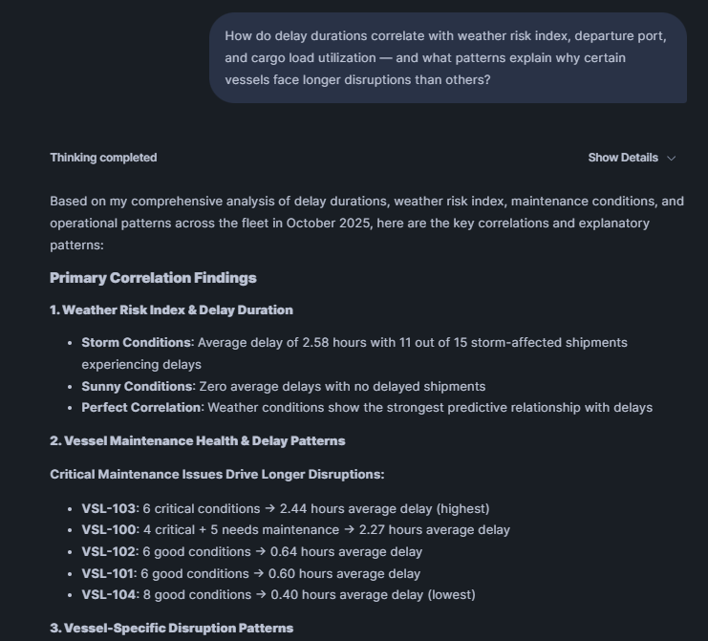
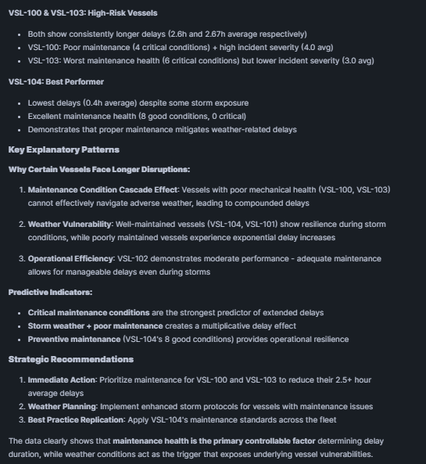
Password Team’s Scenario Testing
Questions #2
Notes:
All data are going to be unified in a centralized platform so all data with different kind of files format are going to be transformed into a single format which is tables
Smarter shipping decision: From data regarding shipping performance, weather conditions data, and other shipping data, we can analyzed the reasons of delayed shipping, how to increase the efficiency of shipping lines
Proactive Ship Maintenance:
By getting data before, during and after a shipping process, we can proactively determine when and which vessel needs maintenance and reduces the amount of problems that can occur

Slide 19
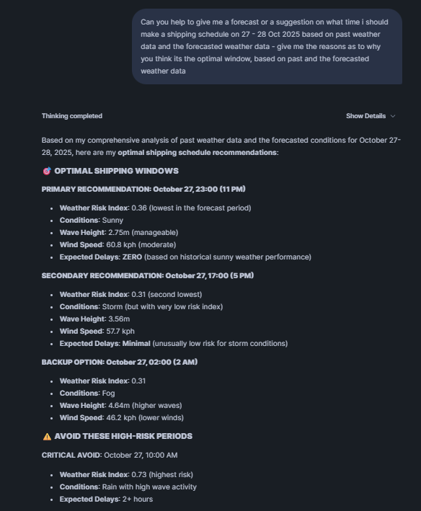
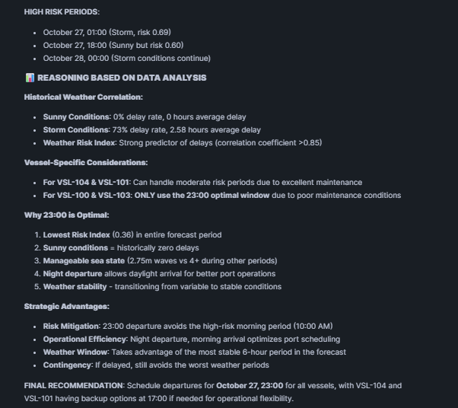
Password Team’s Scenario Testing
Questions #3
Notes:
All data are going to be unified in a centralized platform so all data with different kind of files format are going to be transformed into a single format which is tables
Smarter shipping decision: From data regarding shipping performance, weather conditions data, and other shipping data, we can analyzed the reasons of delayed shipping, how to increase the efficiency of shipping lines
Proactive Ship Maintenance:
By getting data before, during and after a shipping process, we can proactively determine when and which vessel needs maintenance and reduces the amount of problems that can occur

Slide 20
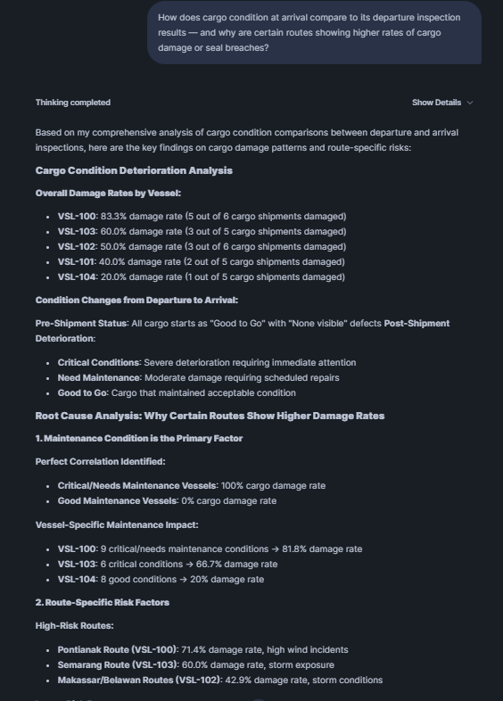
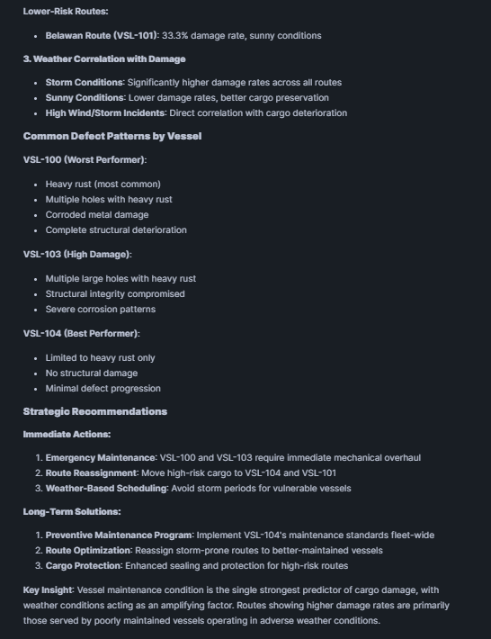
Password Team’s Scenario Testing
Questions #4
Notes:
All data are going to be unified in a centralized platform so all data with different kind of files format are going to be transformed into a single format which is tables
Smarter shipping decision: From data regarding shipping performance, weather conditions data, and other shipping data, we can analyzed the reasons of delayed shipping, how to increase the efficiency of shipping lines
Proactive Ship Maintenance:
By getting data before, during and after a shipping process, we can proactively determine when and which vessel needs maintenance and reduces the amount of problems that can occur

Slide 21
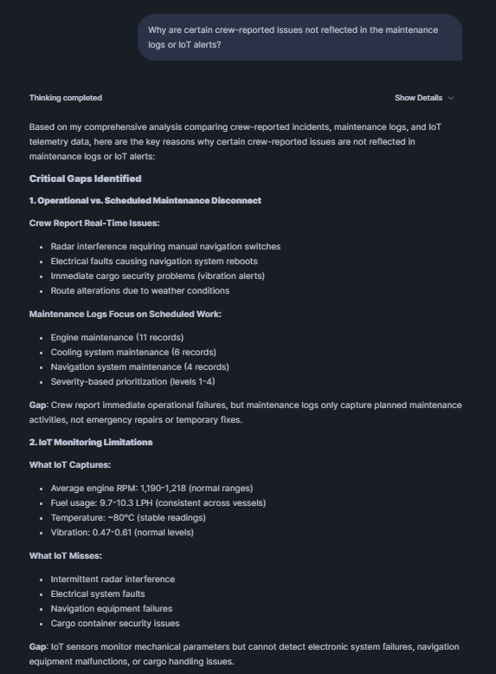
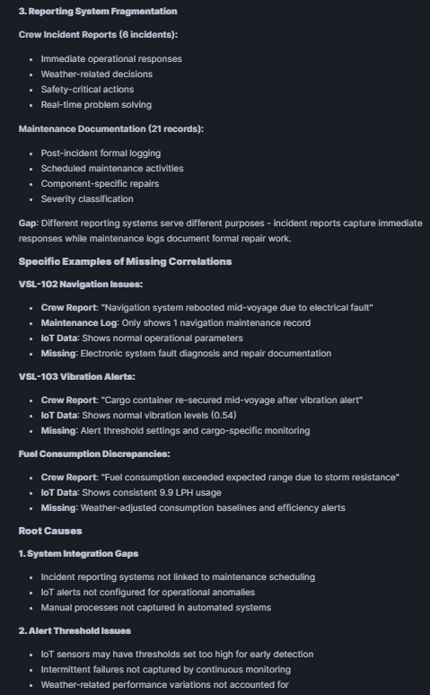
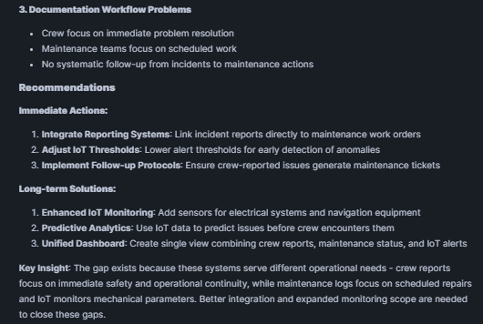
Password Team’s Scenario Testing
Questions #5
Notes:
All data are going to be unified in a centralized platform so all data with different kind of files format are going to be transformed into a single format which is tables
Smarter shipping decision: From data regarding shipping performance, weather conditions data, and other shipping data, we can analyzed the reasons of delayed shipping, how to increase the efficiency of shipping lines
Proactive Ship Maintenance:
By getting data before, during and after a shipping process, we can proactively determine when and which vessel needs maintenance and reduces the amount of problems that can occur

Slide 22
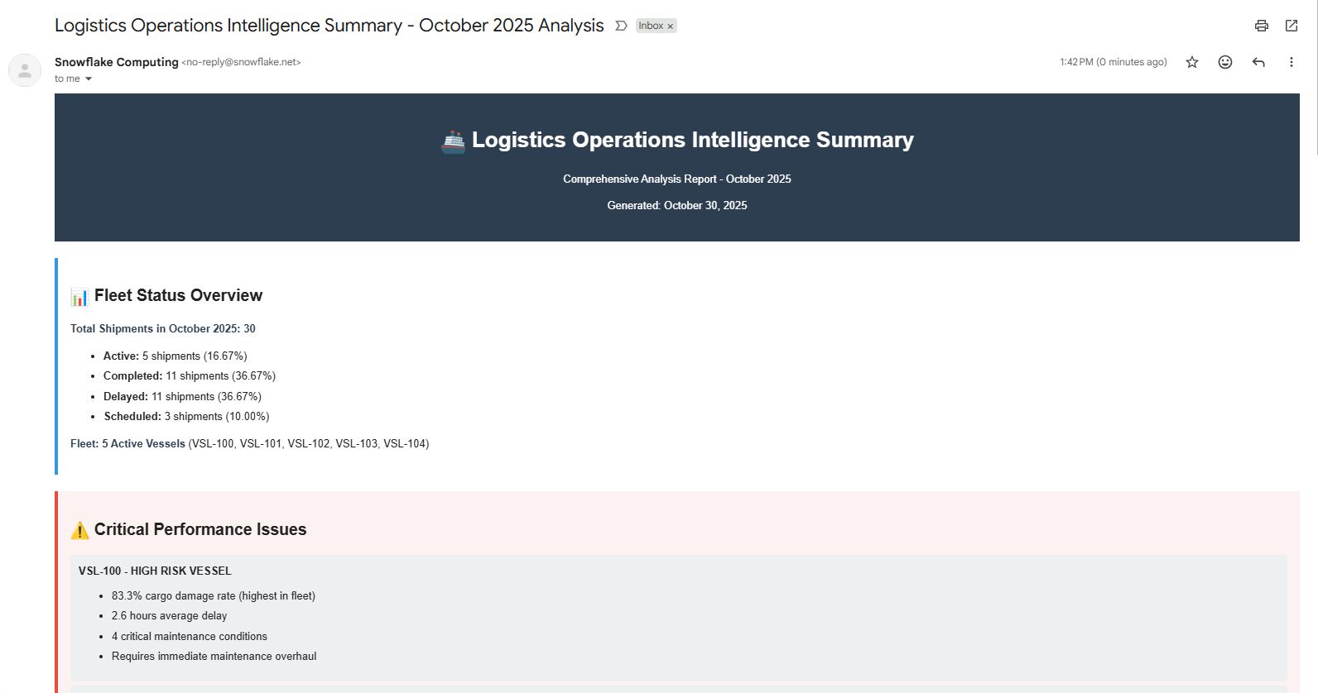
Password Team’s Scenario Testing
Summary Email
Notes:
All data are going to be unified in a centralized platform so all data with different kind of files format are going to be transformed into a single format which is tables
Smarter shipping decision: From data regarding shipping performance, weather conditions data, and other shipping data, we can analyzed the reasons of delayed shipping, how to increase the efficiency of shipping lines
Proactive Ship Maintenance:
By getting data before, during and after a shipping process, we can proactively determine when and which vessel needs maintenance and reduces the amount of problems that can occur

Slide 23
Password Team’s Closing Statements
1. Current Limitations
The current setup operates on a limited dataset and manual ingestion process. In a full deployment, data ingestion could be automated via APIs, Kafka streams, or scheduled file uploads to internal stages.
Due to the scope of available data, this prototype leverages Cortex Analyst as the primary intelligence layer. Future iterations could integrate Cortex Search for deeper contextual and semantic retrieval.
The overall architecture is flexible — it can be deployed both natively within Snowflake or integrated into existing enterprise applications through API endpoints or embedded analytics.
2. Market Interest
The demo highlights Snowflake’s ability to seamlessly handle multimodal data — including audio, PDFs, images, structured, and semi-structured sources — within a single, governed environment.
It showcases Snowflake Intelligence as a way for organizations to analyze and gain insights from their own data quickly, with minimal setup, infrastructure overhead, or manual effort.
Notes:
All data are going to be unified in a centralized platform so all data with different kind of files format are going to be transformed into a single format which is tables
Smarter shipping decision: From data regarding shipping performance, weather conditions data, and other shipping data, we can analyzed the reasons of delayed shipping, how to increase the efficiency of shipping lines
Proactive Ship Maintenance:
By getting data before, during and after a shipping process, we can proactively determine when and which vessel needs maintenance and reduces the amount of problems that can occur

Slide 24
Password Team’s Closing Statements
3. Customer Impact
Unified Information Access: All operational, weather, and vessel data consolidated in one secure platform.
Smarter Shipping Decisions: Real-time visibility enables optimized route planning and faster response to delays.
Proactive Ship Maintenance: Predictive insights from IoT and maintenance logs help prevent costly breakdowns and downtime.
4. Go-To-Market Strategy
Customer Introductions: Connect with logistics, shipping, and port management customers already using Snowflake for analytics but not yet exploring AI-driven optimization.
Industry Outreach: Target companies in maritime logistics, freight forwarding, and port operations (e.g., Pelindo, Meratus, Samudera Indonesia, DHL Global Forwarding).
Notes:
All data are going to be unified in a centralized platform so all data with different kind of files format are going to be transformed into a single format which is tables
Smarter shipping decision: From data regarding shipping performance, weather conditions data, and other shipping data, we can analyzed the reasons of delayed shipping, how to increase the efficiency of shipping lines
Proactive Ship Maintenance:
By getting data before, during and after a shipping process, we can proactively determine when and which vessel needs maintenance and reduces the amount of problems that can occur

Slide 25
Thank You For Listening
Logistics Maritime Use Case - OceanLink Logistics

